Slide 1

WEB SCRAPING PROJECT: OPENRICE​
Airin Konno

Slide 2

Project Outline
Introduction
Aim
Data Collection, Preprocessing
Exploratory Data Analysis
Insights
Challenges and Limitations
Conclusion

Slide 3
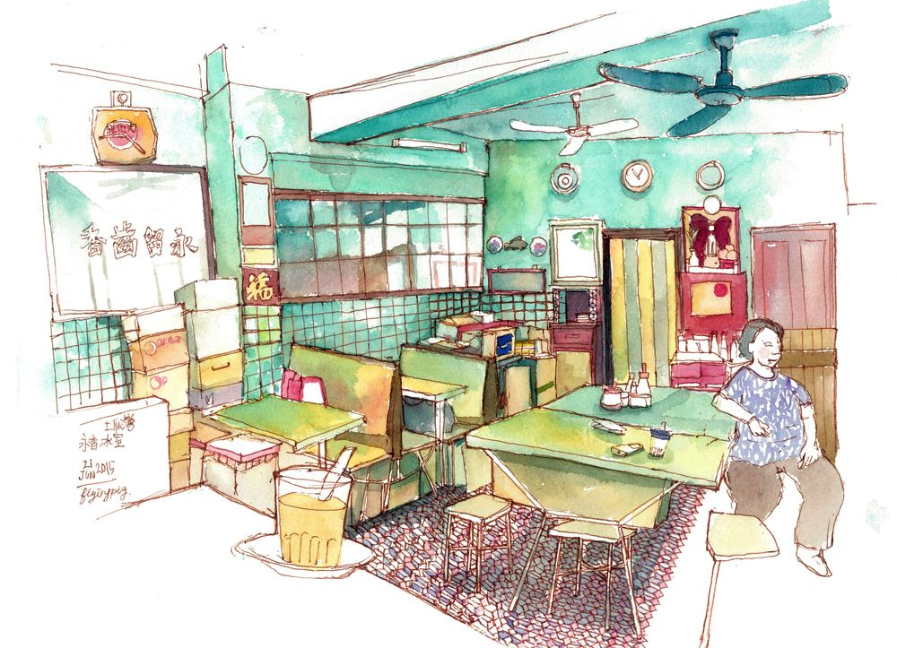
Introduction​
OpenRice is currently the most popular food dining guide in Hong Kong, providing the most comprehensive restaurant information.
As a consumer, it would be an interesting topic to explore the most popular dishes, prices, and districts for the hottest restaurants.
For businesses, it would be useful to have data in order to formulate strategies to improve their website rating, increase profits, as well as look at competitor data.

Slide 4
Aim
This project aims to:
Explore the dataset using pandas.
Create data visualizations using matplotlib and seaborn.
Perform data analysis to explain the data visualizations that have been created.

Slide 5
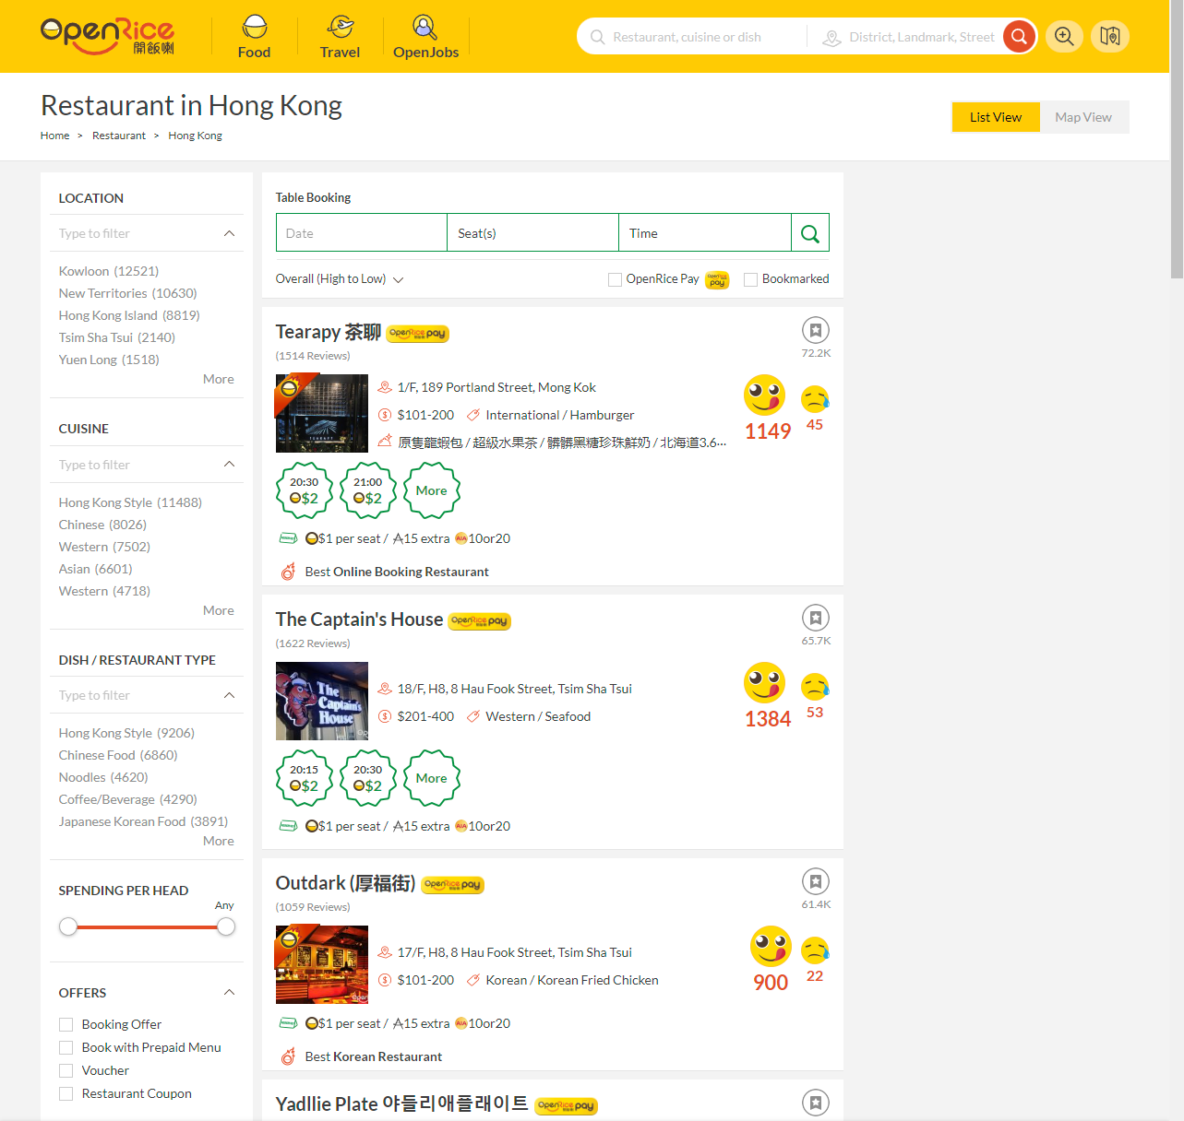
Data Collection
Data was scraped from openrice.com using BeautifulSoup and Selenium.
The restaurants were sorted by "Overall (High to Low)", where restaurants with the most engagement (ratings, bookmarks, reviews) were ranked the highest.
Data scraping was limited to 17 pages (250 restaurants), and could not be scraped further.

Slide 6
Dataset Description
Structure of the dataset
Variable Name | Description | Sample Data
restaurant_name | Name of restaurant | Tearapy 茶聊; Yadllie Plate 야들리애플래이트
price_range_per_head | Pricing per head | $101-200; $201-400...
good_ratings | Number of good ratings | 1149; 1384...
bad_ratings | Number of bad ratings | 45; 53...
full_address | Restaurant address | 1/F, 189 Portland Street, Mong Kok...
district | Restaurant district | Mong Kok; Tsim Sha Tsui...
cuisine | Type of cuisine | International; Western...
dish | Type of dish in particular | Hamburger; Steak House...
written_reviews | Number of reviews written | 1514; 1622...
bookmarks | Number of bookmarks | 72200; 65700...

Slide 7
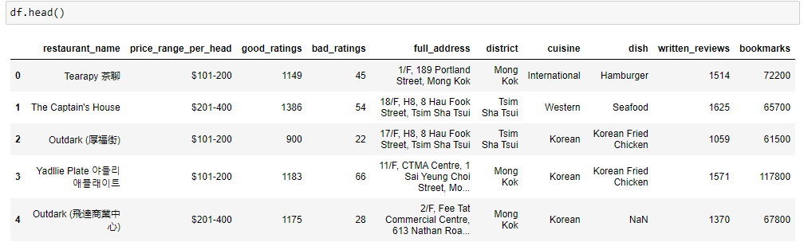
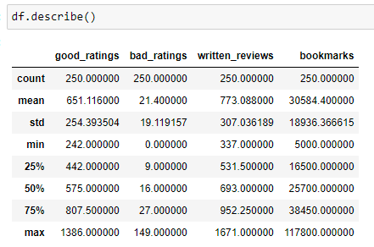
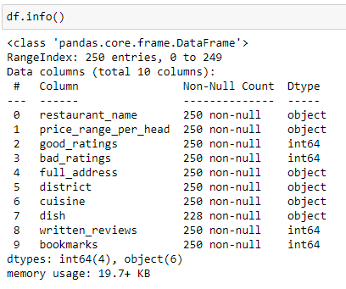
Dataset Info: Initial Data Frame

Slide 8
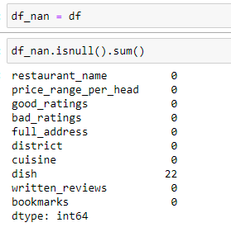
Dataset Pre-Processing: Null Values
To ensure high quality of data, we must clean dirty data.
Handling null values:
There was 22 null values under the column 'dish'.
Based on this, missing values in 'dish' will be omitted.
We end up with 228 rows of data.

Slide 9
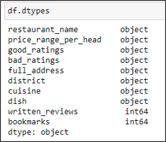
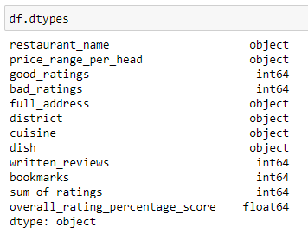
Dataset Pre-Processing: Adding New Columns
For EDA purposes, the overall rating score will be needed.
To do this, we must change the data type of 'good_ratings' and 'bad_ratings' to integers.
New columns:
Sum_of_ratings = good_ratings + bad_ratings
Overall_rating_percentage_score = good_ratings / sum_of_ratings

Slide 10
Dataset Pre-Processing: Feature Engineering
New columns will be created by extracting features present in the dataset for further analysis.
New columns:
Region: Created by grouping districts.
Hong Kong Island
Kowloon
New Territories
Average price per head: Created by getting the average of the price per head range.

Slide 11
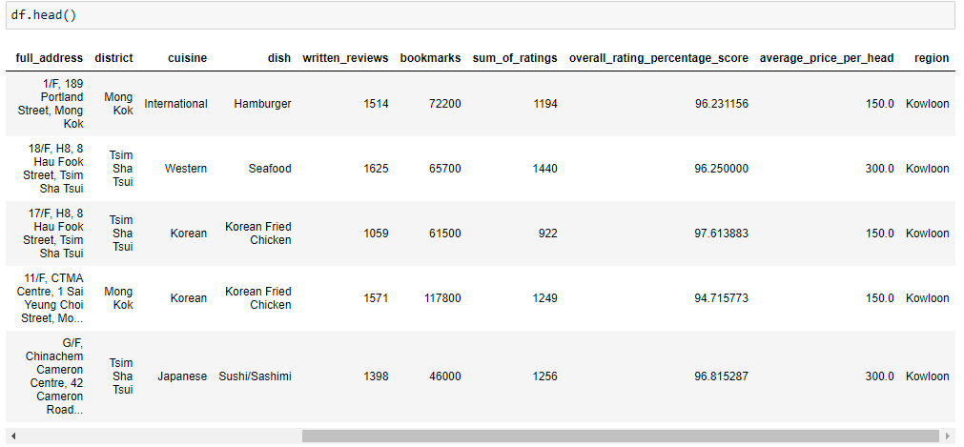
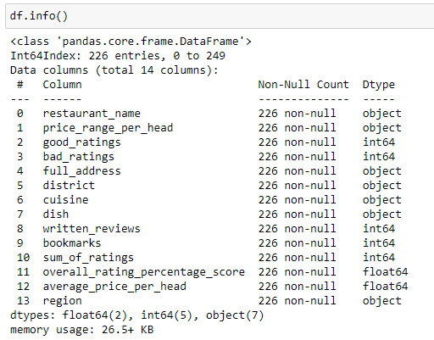
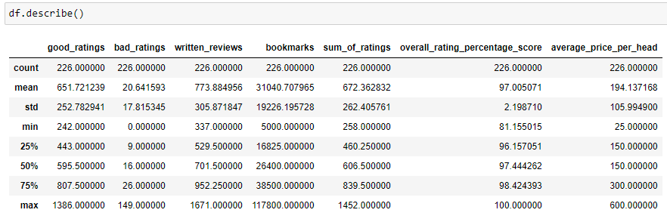
Dataset Info: Final Data Frame

Slide 12
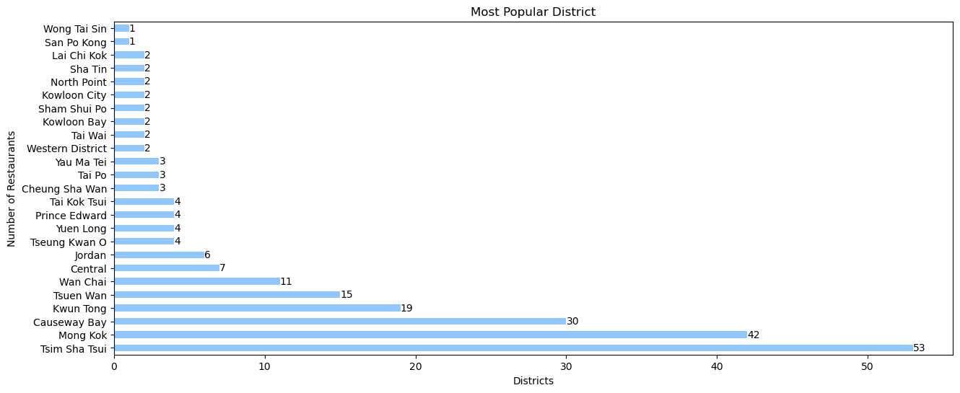
Exploratory Data Analysis: Most Popular District
The top areas for finding good restaurants are in Tsim Sha Tsui, Mong Kok and Causeway Bay

Slide 13
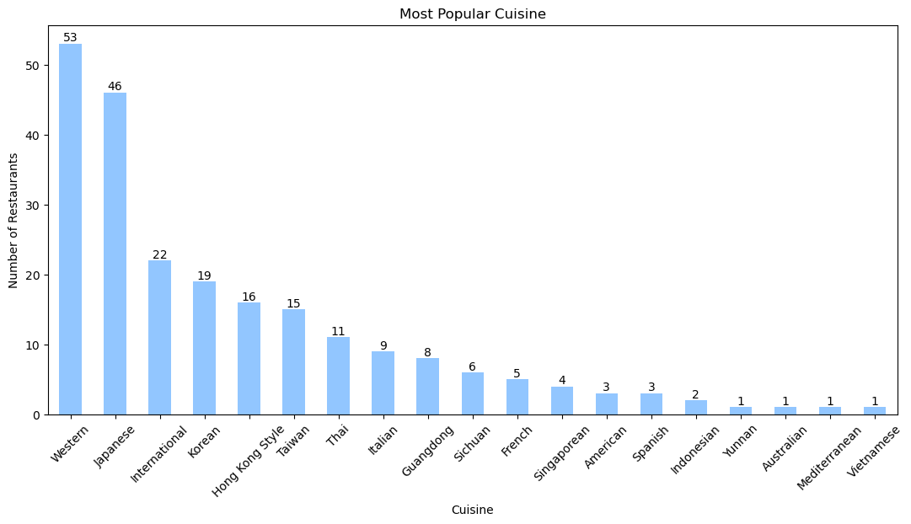
Exploratory Data Analysis: Most Popular Cuisine
The top restaurants serve Western, Japanese, and International cuisine.

Slide 14
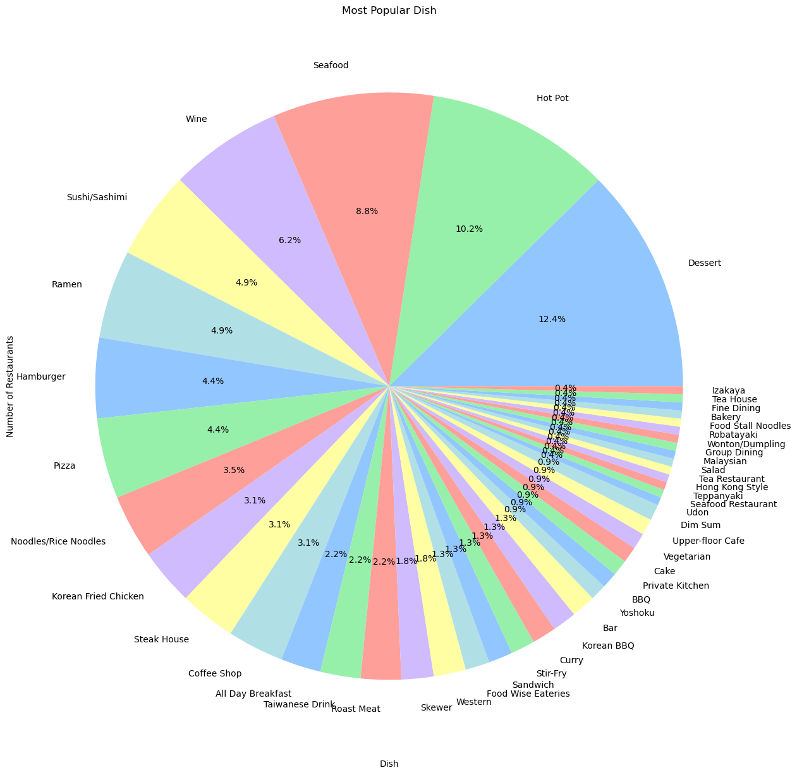
Exploratory Data Analysis: Most Popular Dishes
The top restaurants are mostly populated by dessert, hot pot and seafood restaurants.
Although Japanese cuisine is ranked second, it is surprising to see Sushi/Sashimi and Ramen ranked 5th and 6th in the most popular dishes.

Slide 15
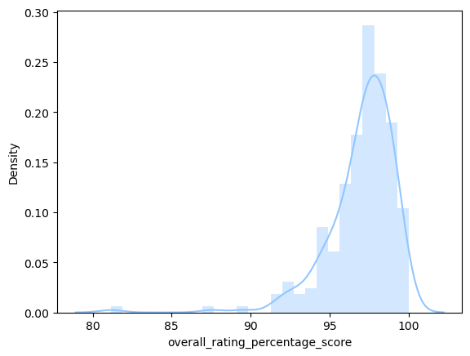
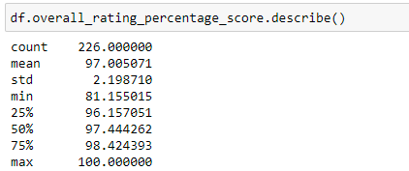
Exploratory Data Analysis: Overall Rating Percentage Score
In the top restaurants, the mean overall rating is 97%, with the min being 81.2% and the max being 100%.

Slide 16
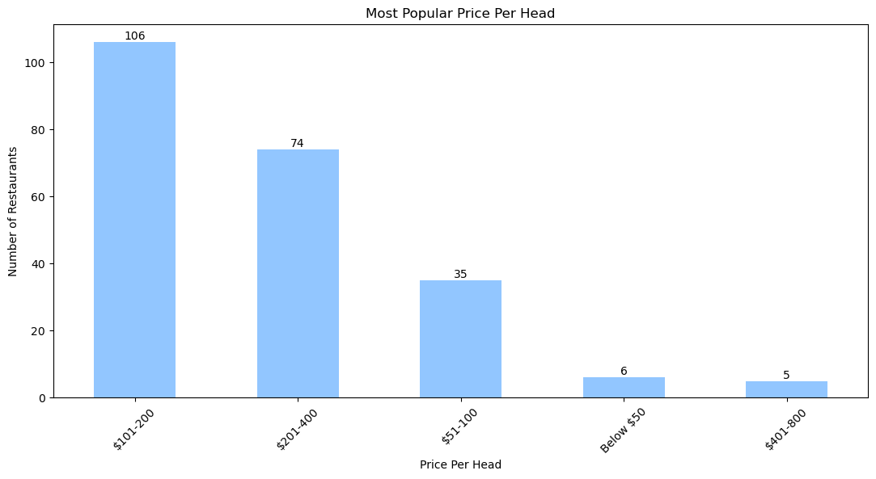
Exploratory Data Analysis: Most Popular Price Per Head
There are the most restaurants within the $101-200pp price range.
There are the least restaurants in the opposite of each spectrum listed in the top restaurants.

Slide 17
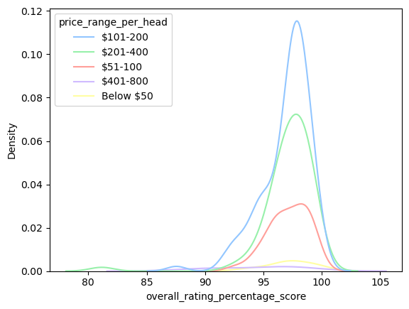
Exploratory Data Analysis: Price Per Head vs Overall Rating
There are more restaurants in the price range of $101-200 with a high overall rating compared to any other price range.
All price ranges follow a similar pattern where they peak at 97-98% overall rating.

Slide 18
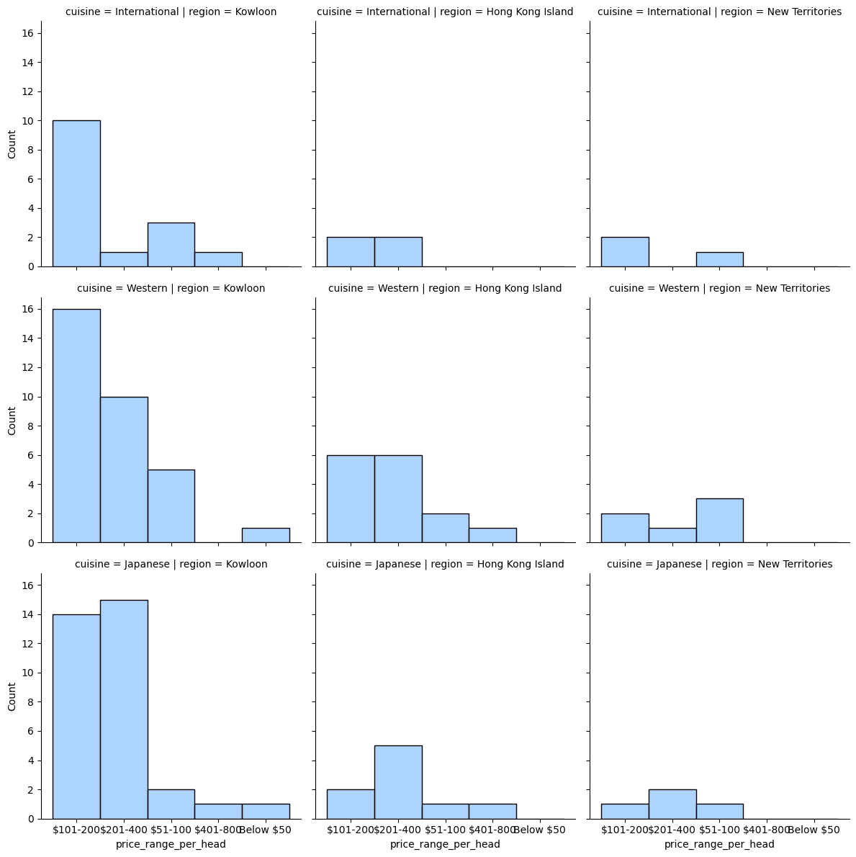
Exploratory Data Analysis: Where To Go On A Budget
Price Distribution for Top 3 Cuisine In Different Regions
A meal at Kowloon and Hong Kong Island would more likely be in the price ranges of $101-200, and $201-400.
In New Territories, you can find good restaurants in the $51-100 range.
If you want Japanese, Western, or International food, Kowloon is a hot spot for all of these food.

Slide 19
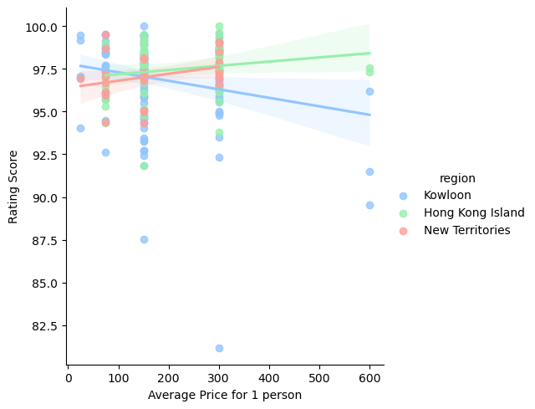
Exploratory Data Analysis: Rating vs Price vs Region
Kowloon: The more you pay, the lower the restaurant scored.
HK Island: The more you pay, the higher the rating.
New Territories: The more you pay, the higher the rating.
Data is limited up to an average price of $300.

Slide 20
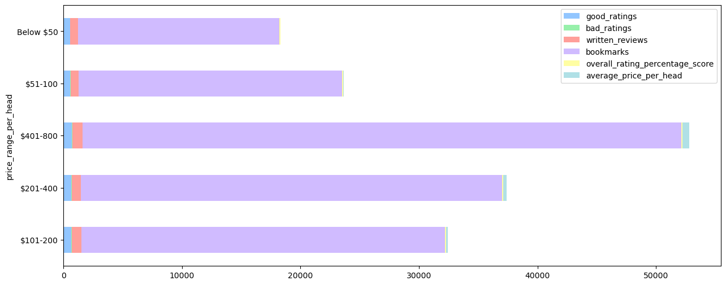
Exploratory Data Analysis: Price Per Head vs Engagement Stats
Number of ratings is similar across all price ranges, but restaurants in the $401-800 range have the most bookmarks.

Slide 21
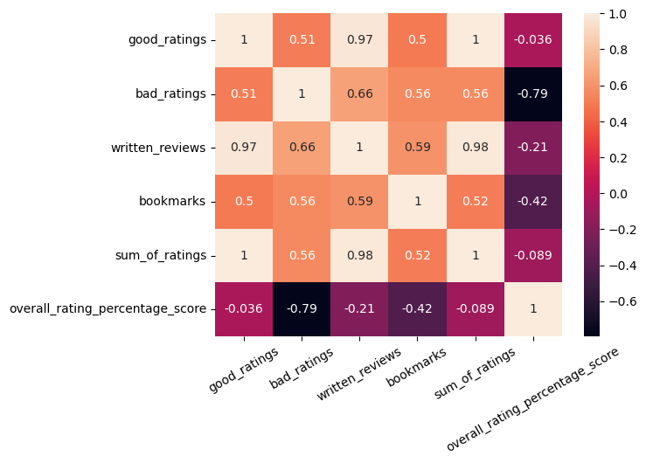
Exploratory Data Analysis: Correlation Between Rating and Engagement
This heat map shows that there is a negative correlation between overall rating and all other types of engagements.

Slide 22
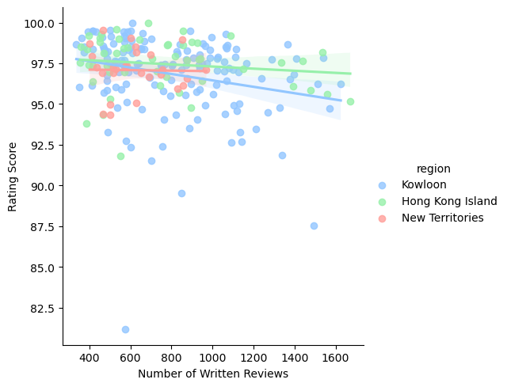
Exploratory Data Analysis: Number of Reviews vs Rating Score
It is surprising to see that there is a negative correlation between number of reviews and rating score.
Despite having more written reviews, the rating score decreases.

Slide 23
Insight Analysis
Customers:
The most popular cuisine amongst OpenRicers are Western, Japanese, and International cuisine, with the most popular dishes being Dessert, Hotpot and Seafood.
Most of the top restaurants are situated in Kowloon (TST and MK).
If you want to spend $100-200, you'd find more good options in Kowloon.
If you want to spend below $100, you'd find good options in New Territories.
You'd want to go to HK Island for more expensive restaurants ,as the more you pay, the higher the rating.
Businesses:
Restaurants in the $401-800 range have the most bookmarks.
You could do a lot of promotions and offers on special days (e.g. Birthday, Weekends, Christmas) to entice these customers to come.
More written reviews, total number of ratings, and bookmarks may actually negatively impact your rating score.
Customers may be more likely to write a complaint than a compliment when writing a review.

Slide 24
Challenges and Limitations
Data is limited to number of web pages available to scrape.
OpenRice only goes up to page 17 (250 restaurants), whereas the website says they have 1.2m restaurants.
Restaurants may not be categorized correctly on OpenRice(e.g. "Western" appearing on both "Cuisine" and "Dish").
Null values for some data.
Slow speed of scraping.

Slide 25

Conclusion
In this project, I looked at popular food categories, areas, and compared price to regions and ratings.
For consumers, I hope this analysis will help you make a better decision of where to eat in the future.
And for businesses, I hope this data helps you find opportunities for growth.

